Slide 1
ESE516 CLOUD STARTER
Eduardo Garcia
Spring 2021

Slide 2
Annex – how to set up SAMW25 for access to Penn’s HTTPS server

Slide 3
Intro
These slides show the process to add the certifications needed for the SAMW25 to have access to files hosted in the SEAS webpage.
This example will add the cert. for my webpage, but you should follow these steps to add it for yours!
https://www.seas.upenn.edu/~edgarc/

Slide 4
Intro
1.) Go to your website. In my example, it is:
https://www.seas.upenn.edu/~edgarc/
(Notice no file extension)

Slide 5
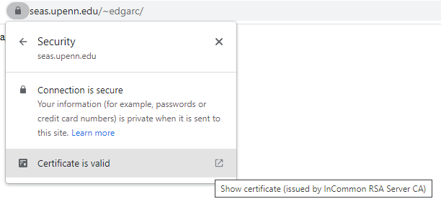

Intro
On your browser there must be a way to download the certificate for the webpage.
On Chrome : Click on the Lock Icon near the URL and click on certificate

Slide 6
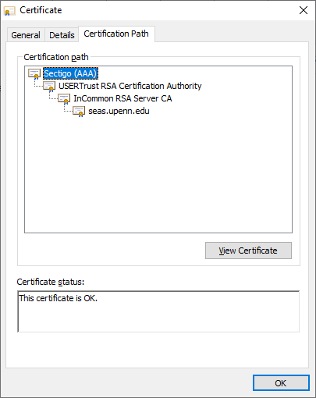
Intro
Go to the Certification Path tab and click on the top certificate path. Then, click on “View Certificate”

Slide 7
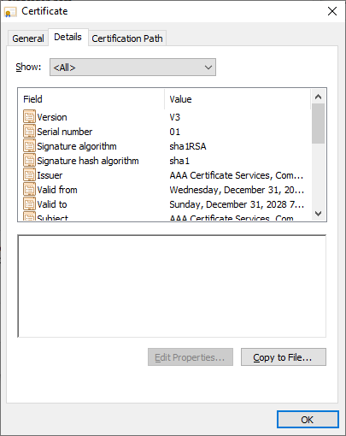
Intro
On the new window that pops up, choose the DETAILS tab, click “Copy to File”

Slide 8
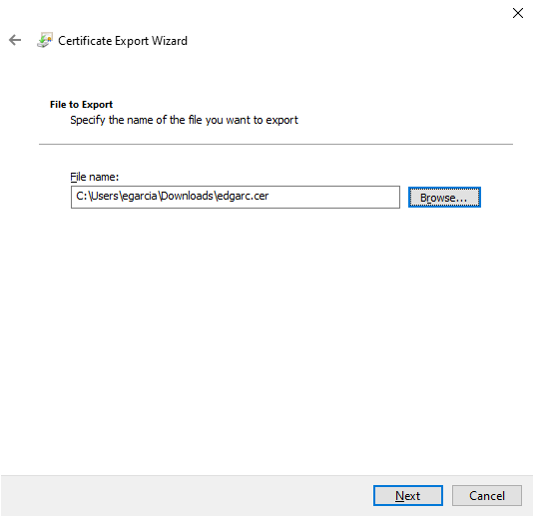
Intro
Click Next and Next, going thru the default settings. Store your file with a short name – I recommend your Penn login

Slide 9
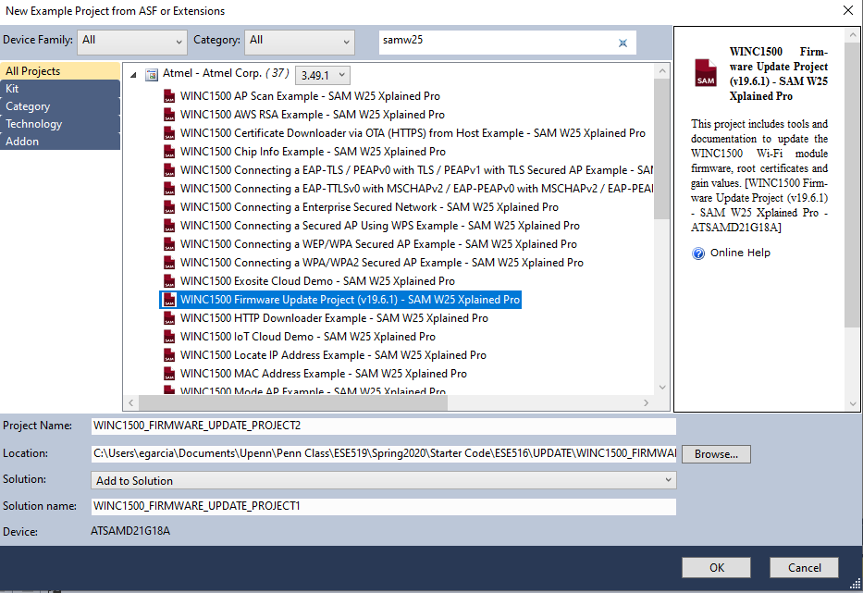
Intro
Open Atmel Studio and generate a new SAMW25 Firmware Update project (File->New-?Example Project). NOTE: Please make the project in a SHORT PATH. Long paths have made the batch file we have to run fail.

Slide 10
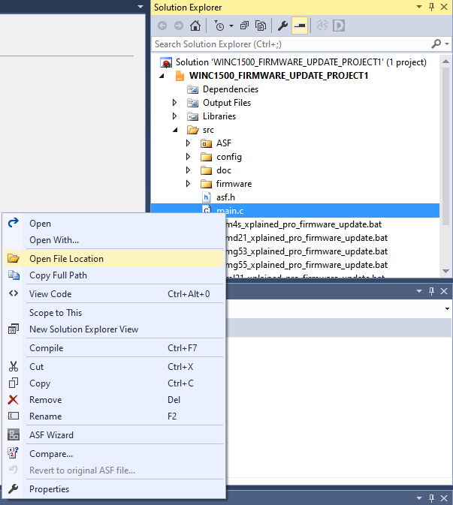
Intro
Go to the folder of the project by right clicking “main.c” and selecting Open File Location

Slide 11
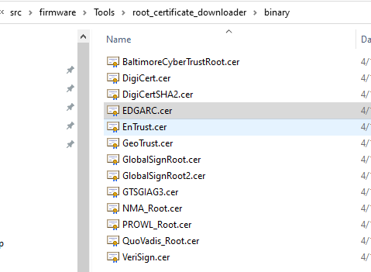
On the path \firmware\Tools\root_certificate_downloader\binary:
Copy the certificate of your webpage into the folder

Slide 12
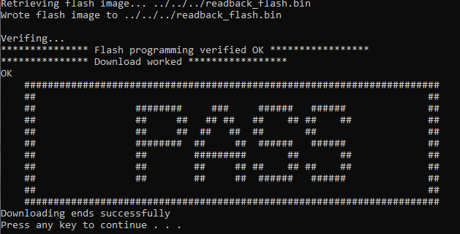
Go thru the normal update procedure! With the certificate, the download should now work!

Slide 13
Annex – how to get Microchip Studio to FINALLY format code nicely!

Slide 14
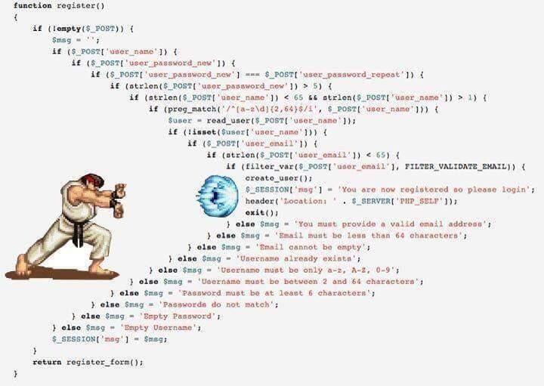
Installing CLANG-FORMAT
Native format has nor worked in Microchip studio since forever.
Here we detail quality of life improvements to writing code

Slide 15
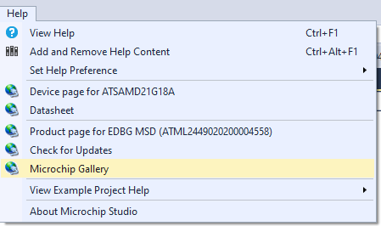
Installing CLANG-FORMAT
We install Clang-Format

Slide 16
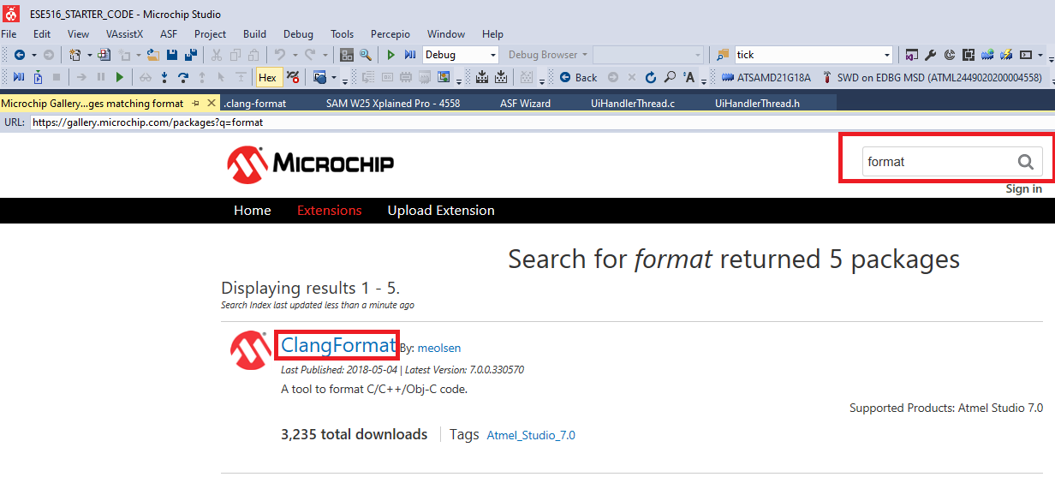
Installing CLANG-FORMAT
We install Clang-Format

Slide 17
Installing CLANG-FORMAT
We install Clang-Format

Slide 18
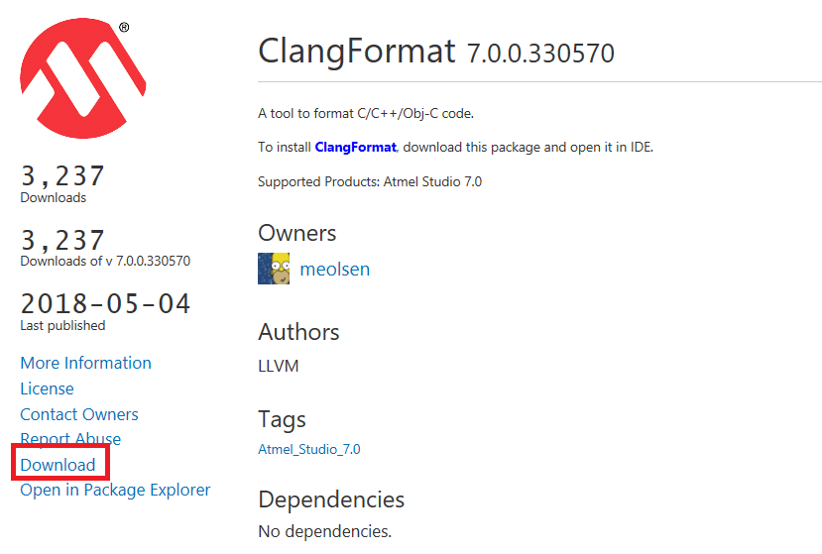
Installing CLANG-FORMAT
We install Clang-Format

Slide 19
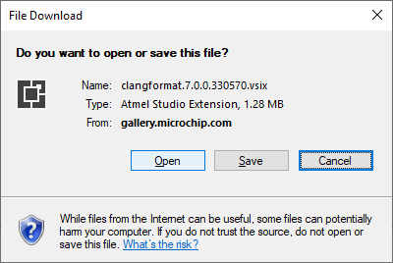
Installing CLANG-FORMAT
We install Clang-Format

Slide 20
Installing CLANG-FORMAT
We install Clang-Format

Slide 21
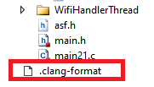
Installing CLANG-FORMAT
Main project has a “.clang-format” file, which basically indicates the rules of formatting to Clang-format.
It is added to the main and bootloader project. Since you are replacing the bootloader with yours, you would need to add this file to the bootloader project as well!
Feel free to edit the clang-format to fit your need if you don’t like this style! (example: indent size, curly braces on new line, etc).

Slide 22
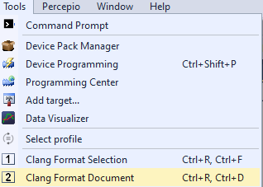
Installing CLANG-FORMAT
On a file, click Tools -> Clang Format Document or do Ctrl + R, Ctrl + D to format the document

Slide 23
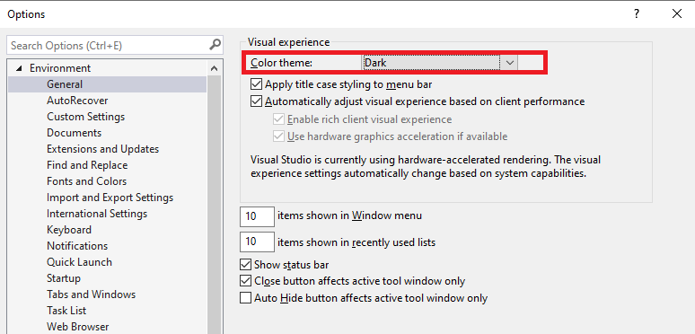
Night mode
You might prefer a dark theme for programming.
Go to Tools -> Options… and do the following:

Slide 24
Using another text editor
IDEs are usually not the best for development – you might prefer another code editor.
I personally use Visual Studio Code to program, and switch to the IDE when it is time to load code/debug.
As an embedded engineer, most of the time you will be writing code. Might as well make it comfy!

Slide 25

Visual Studio Code
Download from https://code.visualstudio.com/

Slide 26
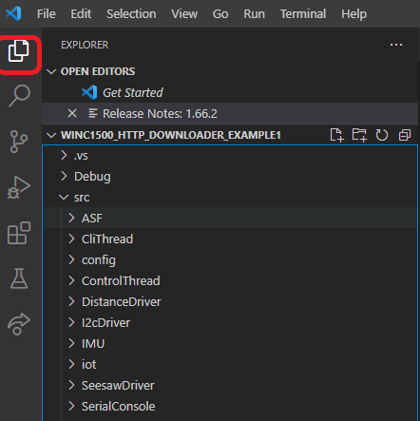
Visual Studio Code
Explorer View: You can use the editor now as you would do in Microchip Studio (except with debugging and loading code!) but we need to add some plugins to make coding more enjoyable.

Slide 27
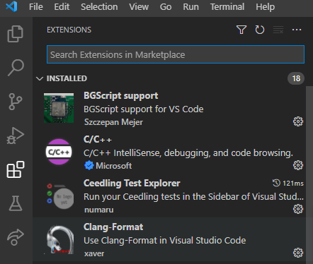
Visual Studio Code
Plugins: Let’s install plugins! You can click on the Plugin button and search for extensions. The following slide has a list of ones to install as a minimum.

Slide 28
Visual Studio Code
C/C++ Plugin
Clang-Format
Doxygen Documentation Generator
Git History and Git Lens – To make using GIT easy!

Slide 29
Visual Studio Code
Once plugins are installed – Open visual studio code and do File -> Open Folder… and open the folder of the main project (The folder of the project you want to work on)
This will open the starter project main application workspace, which is set up to autoformat when saving! Super cool and useful!

Slide 30
Visual Studio Code
We also added a plugin to generate doxygen comments! See https://github.com/cschlosser/doxdocgen#generate-doxygen-comments-in-vs-code

Slide 31
Visual Studio Code
We also added a plugin to generate doxygen comments! Try it out!
1.) Make a function, with any parameters 2.) On top of the function, start a doxygen block (type “/**” and press enter)
The block will be done for you! See next slide

Slide 32
Visual Studio Code

